Slide 1
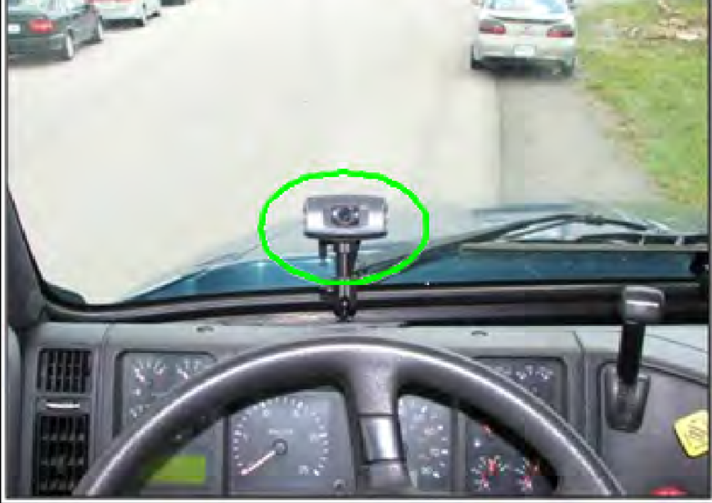
DROWSY DETECTION SYSTEM USING EYE BLINKING SENSOR
Group Name: Tech Warriors
Team Members:
Shravani
K N S Harshita
Nikhila
Chaitanya Bharathi Institute of Technology

Slide 2
Introduction:
Car accident is the major cause of death in which around 1.3 million people die every year.
Majority of these accidents are caused because of distraction or the drowsiness of driver.
Construction of high-speed highway roads had diminished the margin of error for the driver.
The countless number of people drives for long distance every day and night on the highway.
Lack of sleep or distractions like the phone call, talking with the passenger, etc may lead to an accident.
To prevent such accidents we propose a system which alerts the driver if the driver gets distracted or feels drowsy.

Slide 3
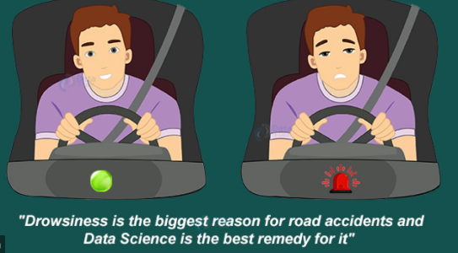
So for this we came up with a solution of using eyeblinking sensor that is attached with the goggles.
A spectacle with eye blink sensor is used to detect the driver drowsiness and alerts the driver with buzzer, if driver is affected by drowsiness.
This can be implemented by hardware and also the software.
We had chosen the hardware by using components and software by using IBM Cloud infrastructure.
The components we chose for the solution is one Arduino UNO,Buzzer,two IR sensors. We can also use alcohol sensor,it would be an extra use for the solution.
In IBM cloud we will be creating the credentials and which is used to store the solution data.

Slide 4
Qualitative Impact:
Every year,thousands of vehicles are involved in crashes which are attributed to the onset of driver drowsiness.
Driving a car is a complex, multifaceted and potentially risky activity requiring full mobilization of physiological and cognitive resources to maintain performance over time. Any loss of these resources can have dramatic consequences, including accidents. Moreover, the promise of autonomous vehicles makes it even more important to determine the driver’s operational state. This has recently generated a large number of studies, both from the fundamental perspective and with a view to potential applications. The challenge is ambitious: not only detecting, but also predicting, degradation in the driver’s operational state.
A driver’s operational state while driving a car involves a complex set of psychological, physiological and physical parameters. During driving activities, several factors can be critical: in particular, fatigue and monotony may cause a loss of attention, drowsiness and even sleepiness (Dong et al., 2011). The present study focuses on a specific type of impaired operational state: drowsiness.
Drowsiness is an intermediate state between alertness and sleep. In this article, we will consider drowsiness as a continuum, or scalar state. Unfortunately, drowsiness cannot be recorded directly but has to be estimated, and several estimation techniques have been proposed earlier.
The reliability and accuracy of drowsiness of a driver is more and precise by using this method of sensor technology.

Slide 5
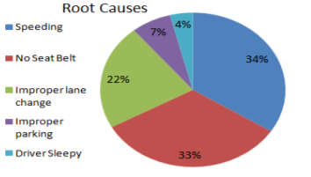
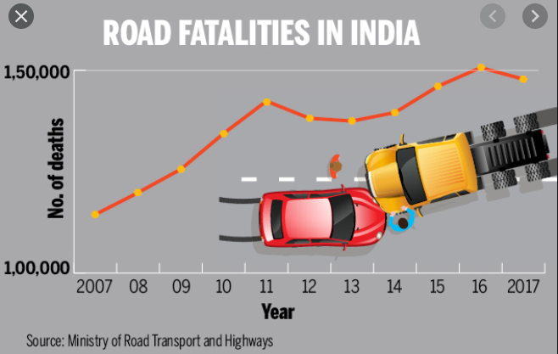
Quantitative Impact:
Previous researches by AAA foundation found that:
In today’s fast-moving world, ever increasing vehicles and human population has triggered the necessity of driver and intelligent safety systems.
In all the accidents involved roughly about 26.3% are fatal and around 1.5 lakh people died in 2019 alone . Hence there is an increase in effort to incorporate intelligent systems in vehicles which increase the safety and stability and move towards Internet of Things which says about vehicle connectivity, Value added functions which reduce the human intervention. Also, we move towards digitalization where integration of digital technologies is done in everyday life.
In given 206 accidents (76 Fatal; 56 Serious injury; 40 Minor injury; and 34 No injury cases) 64% of accidents were either a fatal or a serious accident.
Out of 206 accidents, there were 170 accidents recorded with clear weather condition. Of these 170 accidents, there were 159 accidents happening at no junction involvement. This signifies even though the weather was clear and driver had no junction the accidents rates (77%) were high.
Out of 159 accidents the effect of No driver distraction was found in 44 accidents, 70 accidents were due to sleepy condition and 45 accidents due to other reasons.

Slide 6
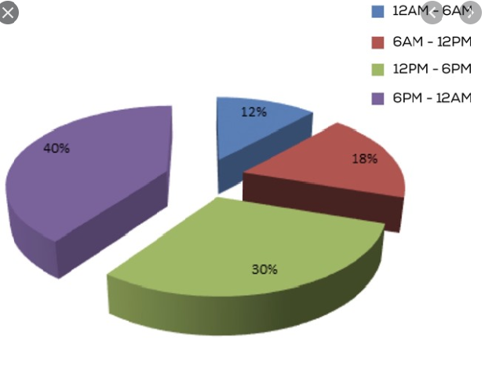
We found that, 51.10% of the accidents were caused by human error and 36.10% from the vehicle error.
Even though the conditions were clear weather, no intersection, no vision obstruction and no driver distraction which strongly emphasizes to incorporate intelligent systems in vehicles which shall ensures occupants safety.
Also, it should be looked for cost efficient solution to target country like India.
From this,it was evident that ≈14% of cases had human error as driver falling asleep.
However, 14% was after the filters were applied. It is believed “driver falling asleep” nhave a higher share for overall accidents.
64% accidents have occurred in time range 1 (6am and 11 am) and time range 5 (12 am to 6am).
Out of these 26% accidents occurred between 6am and 11am, 38% accidents have occurred between 12am to 6am
Of 64% accidents: In 17% cases driver’s condition (fatigue/ sleep/ drowsiness) was responsible .
In 35% cases driver was haltig off the road or on the shoulder and got hit by a moving vehicle

Slide 7
THANK YOU

